Slide 1

PRAGATI ENGINEERING COLLEGE(AUTONOMOUS)
Approved by AICTE, permanently affiliated to JUNTUK Kakinada accredited by NBA & NAAC ‘A+’ Grade
Project Title:
CIFAKE: Image Classification and Explainable Identification of AI - Generated Synthetic Images
Project supervisor: Mrs. D. Chakra Satya Tulasi M.tech,
TEAM 08:
S. Annapurna (21A31A4427)
P. Samyuktha (21A31A4418)
B. Srikanth (21A31A4443)
G. Sneha Ratna (21A31A4410)
G. L. Shiva Teja (21A31A4445)

Slide 2
TABLE OF CONTENT
Abstract
Existing System Overview
Limitations Of Existing System
Proposed System Overview
Advantages Of Proposed System
Software Requirements
Algorithms
Screenshots
Future Implementation
Conclusion

Slide 3
ABSTRACT
A synthetic dataset was generated using latent diffusion to create high-quality AI images that mimic the CIFAR-10 dataset, enabling comparison with real photographs. The project addressed a binary classification problem, distinguishing between real and AI-generated images, using Convolutional Neural Networks (CNNs) for classification. After training 36 CNN architectures and optimizing hyperparameters. Gradient Class Activation Mapping (Grad-CAM) was applied to interpret the model’s decision-making process, revealing that the model relied on small background imperfections rather than the main entity in the image.

Slide 4
EXISTING SYSTEM OVERVIEW
Existing system use advanced techniques like LDMs (e.g., Stable Diffusion, DALL-E, Imagen) to detect AI-generated images, which are visually complex and hard to identify. Detection methods such as DE-FAKE, EfficientNet, Vision Transformers, Optical Flow, and CNN-LSTM models show promise but still face challenges with high-quality images, generalization across datasets, and limited interpretability.

Slide 5
LIMITATIONS OF EXISTING SYSTEM
Reliance on Visual Glitches: Methods depend on visible imperfections, which are rare in advanced models.
Lack of Interpretability: Most models are black-boxes, making them unreliable for sensitive use cases.
Missed Subtle Features: Current methods often overlook small imperfections in high-quality images.
Accuracy Challenges: Existing methods struggle with low accuracy, especially for high-fidelity images.

Slide 6
PROPOSED SYSTEM OVERVIEW
The system employs a fine-tuned CNN to classify real and synthetic images, supported by Grad-CAM to visualize decision-making regions. It introduces the CIFAKE dataset with 60,000 real and 60,000 synthetic images. A dynamic retraining mechanism helps the model adapt to evolving synthetic image features. This approach focuses on detecting subtle visual anomalies. Overall, it offers improved performance compared to existing detection methods.

Slide 7
ADVANTAGES OF PROPOSED SYSTEM
Higher Accuracy: The CNN achieves more accuracy, out performing existing methods for high-quality synthetic images.
Improved Explainability: Grad-CAM visualizes key features, enhancing model transparency over black-box methods.
Dynamic Adaptability: The system updates itself through retraining to handle new synthetic image challenges.
Focus on Subtle Imperfections: The system detects small glitches and anomalies, improving detection of high-fidelity synthetic images.

Slide 8
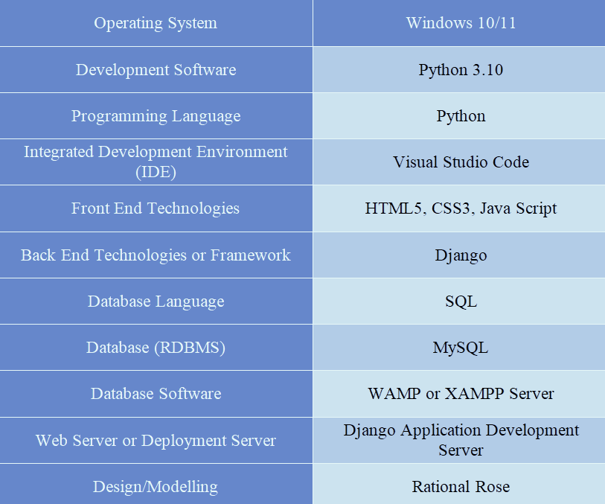
SOFTWARE REQUIREMENTS

Slide 9
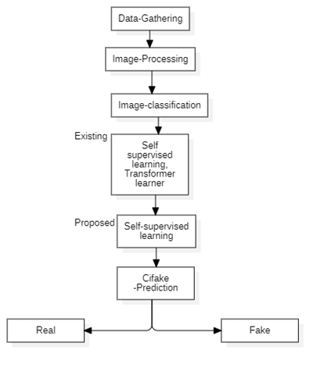
ARCHITECTURE AND FLOW OF SYSTEM
Model Training: 36 Convolutional Neural Network (CNN) architectures are trained on the dataset for binary classification.
Interpretability: Grad-CAM is applied to visualize the regions influencing the model’s decisions.
Image Generation: Synthetic images are created using a latent diffusion model to mimic the CIFAR-10 dataset.
Data Preprocessing: Both real and synthetic images are resized, normalized, and prepared for CNN input.
Prediction: The trained models classify images as either real or AI-generated (fake).
Fig-1 System Architecture

Slide 10
ALGORITHMS
01
CNN Algorithm
A deep learning model that learns
features from images for tasks like classification.
02
Grad-CAM Algorithm
A technique that visualizes image areas influencing a model’s prediction

Slide 11
CNN WORKFLOW
CODE PART:-
# CNN Model Architecture
model = Sequential([
Conv2D(32, (3, 3), activation='relu', input_shape=(IMG_WIDTH, IMG_HEIGHT, 3)),
BatchNormalization(),
MaxPooling2D(pool_size=(2, 2)),
Dropout(0.25), Conv2D(64, (3, 3), activation='relu'),
BatchNormalization(),
MaxPooling2D(pool_size=(2, 2)),
Dropout(0.25), Conv2D(128, (3, 3), activation='relu'),
BatchNormalization(),
MaxPooling2D(pool_size=(2, 2)),
Dropout(0.25), Flatten(),
Dense(128, activation='relu'),
BatchNormalization(),
Dropout(0.5),
Dense(1, activation='sigmoid')
])
STEPS:-
1. Import necessary libraries
2. Loading the data
3. Data augmentation to improve generalization
4. Data Generators
5. CNN Model Architecture
6. Compile the model
7. Train the model
8. Save the model
9. Evaluate the model
10. Calculate accuracy

Slide 12
GRAD-CAM
CODE PART:-
def compute_gradcam(img_array, model, layer_name='conv2d_3'):
grad_model = tf.keras.models.Model([model.inputs], [model.get_layer(layer_name).output, model.output])
with tf.GradientTape() as tape:
conv_outputs, predictions = grad_model(img_array)
loss = predictions[:, 0] grads = tape.gradient(loss, conv_outputs)
guided_grads = tf.multiply(conv_outputs, grads) pooled_grads = tf.reduce_mean(guided_grads, axis=(0, 1, 2))
conv_outputs = conv_outputs[0] heatmap = tf.reduce_sum(tf.multiply(pooled_grads, conv_outputs), axis=-1) heatmap = np.maximum(heatmap, 0) / tf.reduce_max(heatmap) # Normalize the heatmap
return heatmap.numpy()
Grad-CAM creates a heat map that highlights image regions most influential to a model’s prediction. It uses feature maps from a convolutional layer and weights them using gradients of the predicted class. The resulting heat map reveals where the model is focusing, helping interpret deep learning decisions.

Slide 13
SCREENSHOTS

Slide 14

HOME PAGE
Fig-2 Home Page

Slide 15
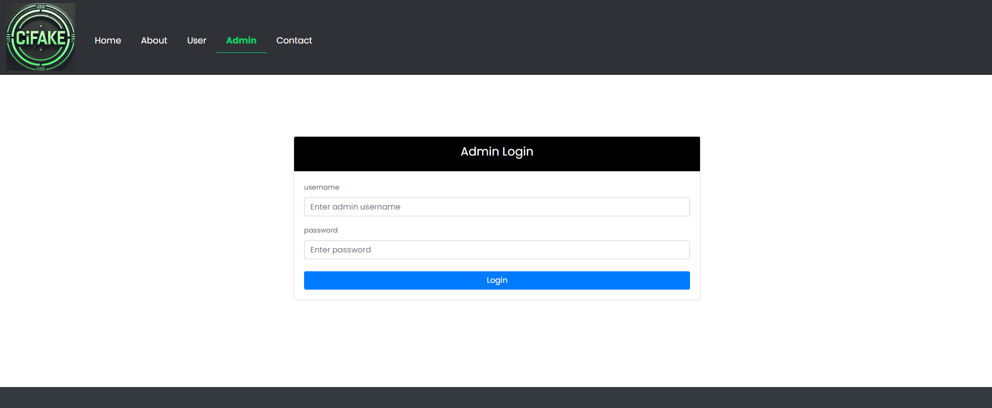
ADMIN LOGIN PAGE
Fig-3 Admin Login Page

Slide 16
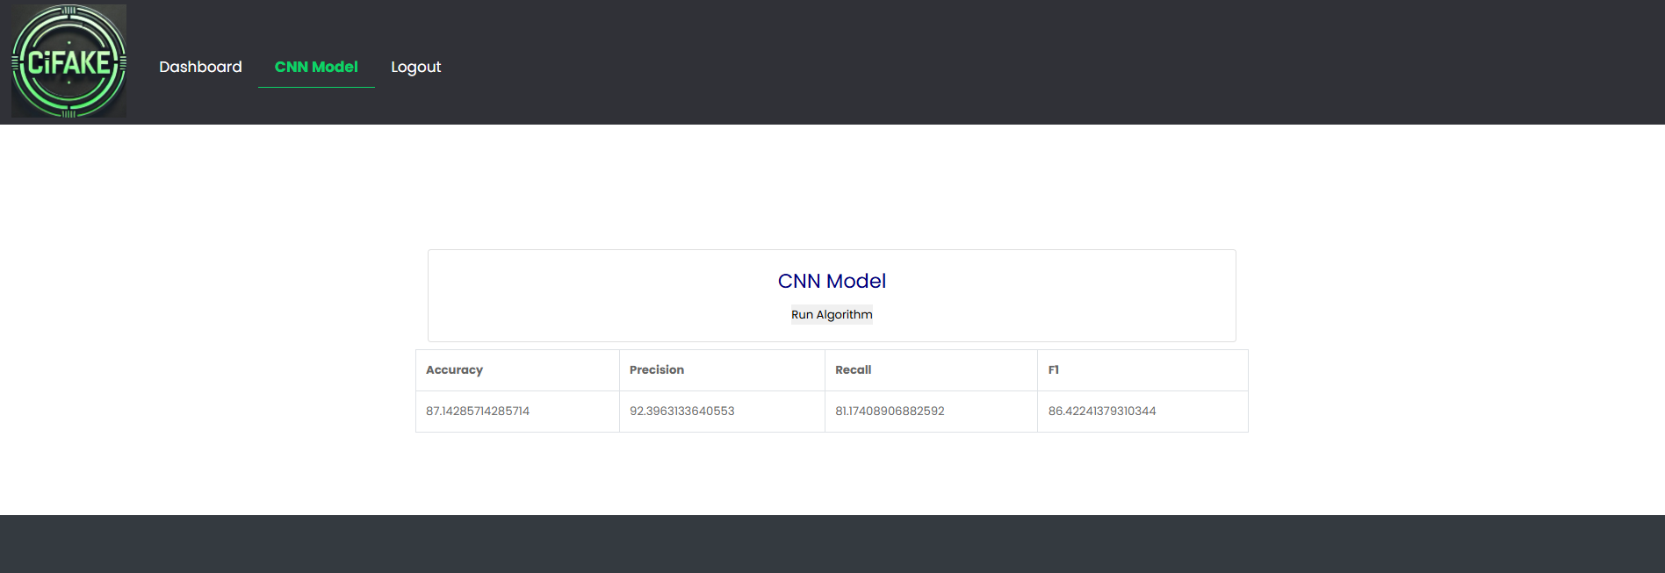
CNN MODEL
Fig-4 CNN Model Page

Slide 17
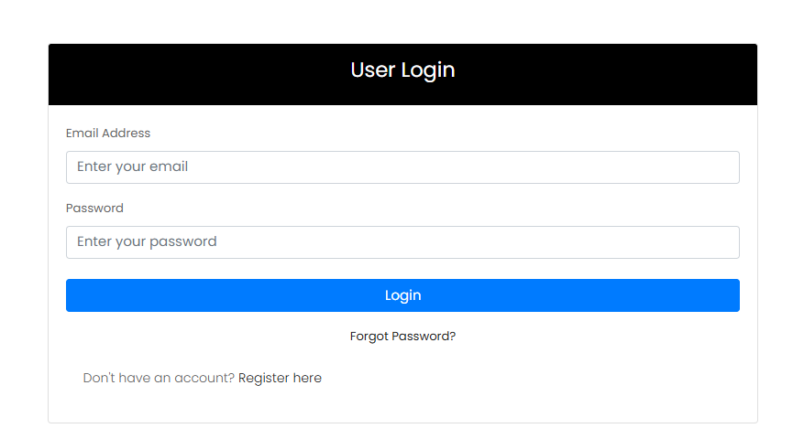

USER LOGIN AND REGISTRATION PAGE
Fig-5 User Login and Registration Page

Slide 18
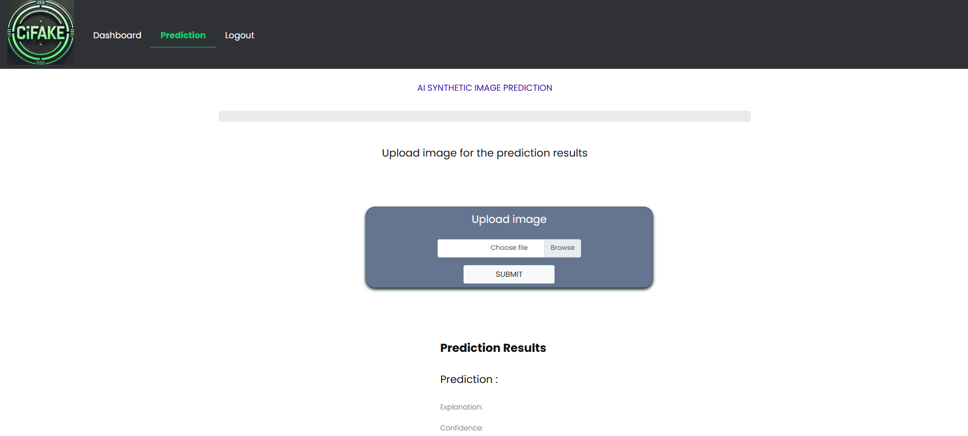
PREDICTION PAGE
Fig-6 Prediction Page

Slide 19
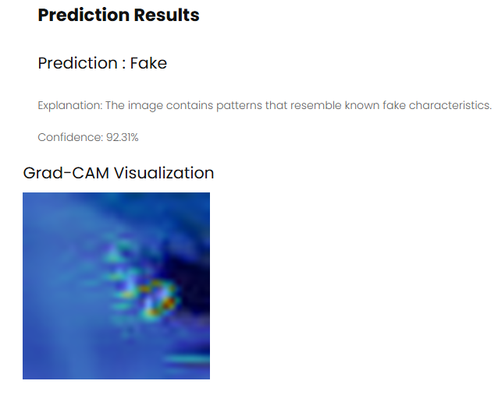
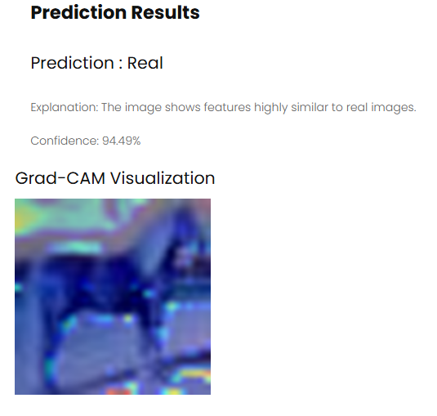
PREDICTION RESULTS (REAL OR FAKE)
Fig-7 Prediction Results(Real or Fake)

Slide 20
FUTURE IMPLEMENTATION
Future work can focus on attention-based models like Transformers to boost prediction accuracy and interpretability. Updating the CIFAKE dataset and expanding it to other domains, such as healthcare or facial recognition, could enhance its applicability. Incorporating Explainable AI (XAI) techniques will further improve transparency and help build trust in predictions, supporting better decision-making.

Slide 21
CONCLUSION
The project significantly improved the accuracy of recognizing AI-generated images and introduced the CIFAKE dataset to support future research. It addresses the critical challenge of verifying the authenticity of visual data, which is essential in combating misinformation and protecting digital integrity. By combining advanced deep learning techniques with explainable AI, the system enhances trust and transparency. The dataset also provides a valuable resource for benchmarking and developing robust detection models across multiple domains.

Slide 22
THANK YOU
Any Questions?

